Slide 1

SOUTH CAROLINA CONFERENCE

Slide 2
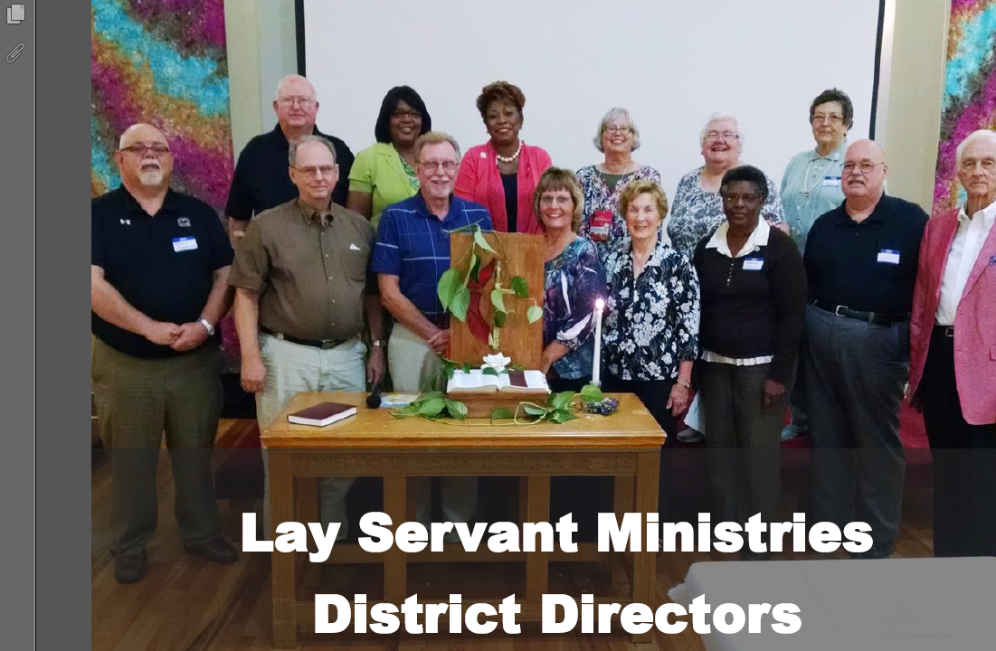

Slide 3

Local Church Lay Servant
Certified Lay Servant
Lay Speaker (Pulpit Supply)

Slide 4
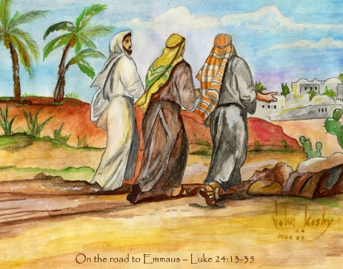




Information for the Journey
Notes:
Sandy
Rather than just flipping through the Guide, we’re going to present it in terms of ten tools that you can take away to lead your district and conferences. As we discuss them there will be ready references to pages and diagrams that will allow you to follow along.
There are 10 of them. Here are the first five. They include Book of Discipline that tells us Who we Are; a description of our responsibilities that tell us what we do; a Mission Matrix to give us the focus of What we do; a Lay Servant Ministries System to assist in how we do it; a Brochure to aid in telling others.
SLIDE

Slide 5

The Book of Discipline
BOD ¶266, 631.6, 668
As Lay Servants.. “professing members”
As Lay Servants we Lead, Care, Communicate.
And give primary attention to our church or charge.
As Directors we Direct and Lead our Committees
Notes:
Sandy
And the first tool is this month’s Book of Discipline, hot off the press. It first and foremost defines who we are and what our ministry is.
Paragraph 266 describes who we are as Lay Servants. First, we are professing members of a local church or charge, and we Lead, Care, Communicate, give our primary attention there.
Paragraphs 631.6 and 668 define who we are as leaders in our districts and conferences. We are directors who form and lead committees tasked with calling, equipping and sending laity into the mission field.
So our first tool is the Book of Discipline. I am going to call on Rick to talk about our next tool, Our Missional task. Rick
SLIDE

Slide 6
Section XL 266
Lay Servant – 3. Through continued study and training a lay servant should prepare to undertake one or more of the following functions, giving primary attention to service within the local church or charge.
a) To take initiative in giving leadership, assistance, and support to the program emphases of the church.
b) To lead meetings for prayer, training, study, and discussion when requested by the pastor, district superintendent, or committee on Lay Servant Ministries.
c) To conduct, or assist in conducting, services of worship, and present sermons and addresses when requested by the pastor, district superintendent, or committee on Lay Servant Ministries.
d) To relate to appropriate committees and ministry areas in providing leadership for congregational and community life and fostering caregiving ministries.
e) To assist in the distribution of the elements of Holy Communion whenever celebrated upon request by the pastor of the church of which the lay servant is a member.

Slide 7
WHO IS WHO IN LSM
For beautiful eyes, look for the good in others; for beautiful lips, speak only words of kindness; and for poise, walk with the knowledge that you are never alone.
Notes:
Sandy
Hear the word of God, of Jesus’ teaching: “When Jesus saw the crowds, he went up the mountain; and after he sat down, his disciples came to him. Then he began to speak, and taught them..” Mt 5:1-2.
Jesus did not send his disciples without the tools. His command to “Go” would have been empty without Jesus first equipping them with the tools needed for the task. As leaders and directors, we stand in the place of Jesus, equipping our district directors, then the laity of the Body of Christ so that within their congregations within their communities, when they hear the Spirit urging them to “Go,” they will know they are equipped.
Let us pray: …. Amen.

Slide 8

Local Church Lay Servant
(2012 Book of Discipline)

Slide 9
Local Church Lay Servants:
Serve the local church or charge in any way in which their witness or leadership and service inspires the laity to a deeper commitment to Christ and a more effective discipleship, including through the interpretation of the Scriptures, doctrine, organization, and ministries of the church.

Slide 10
Local Church Lay Servant:
Through continued study and training, a local church lay servant should prepare to undertake one or more of the following functions giving primary attention to service within the local church or charge.
Upon the request of the Pastor, the Local Church Lay Servant:

Slide 11
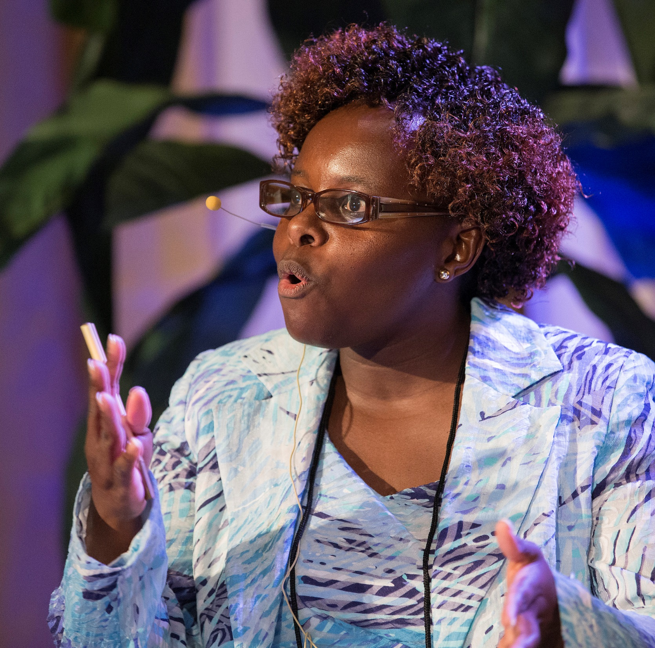


Slide 12
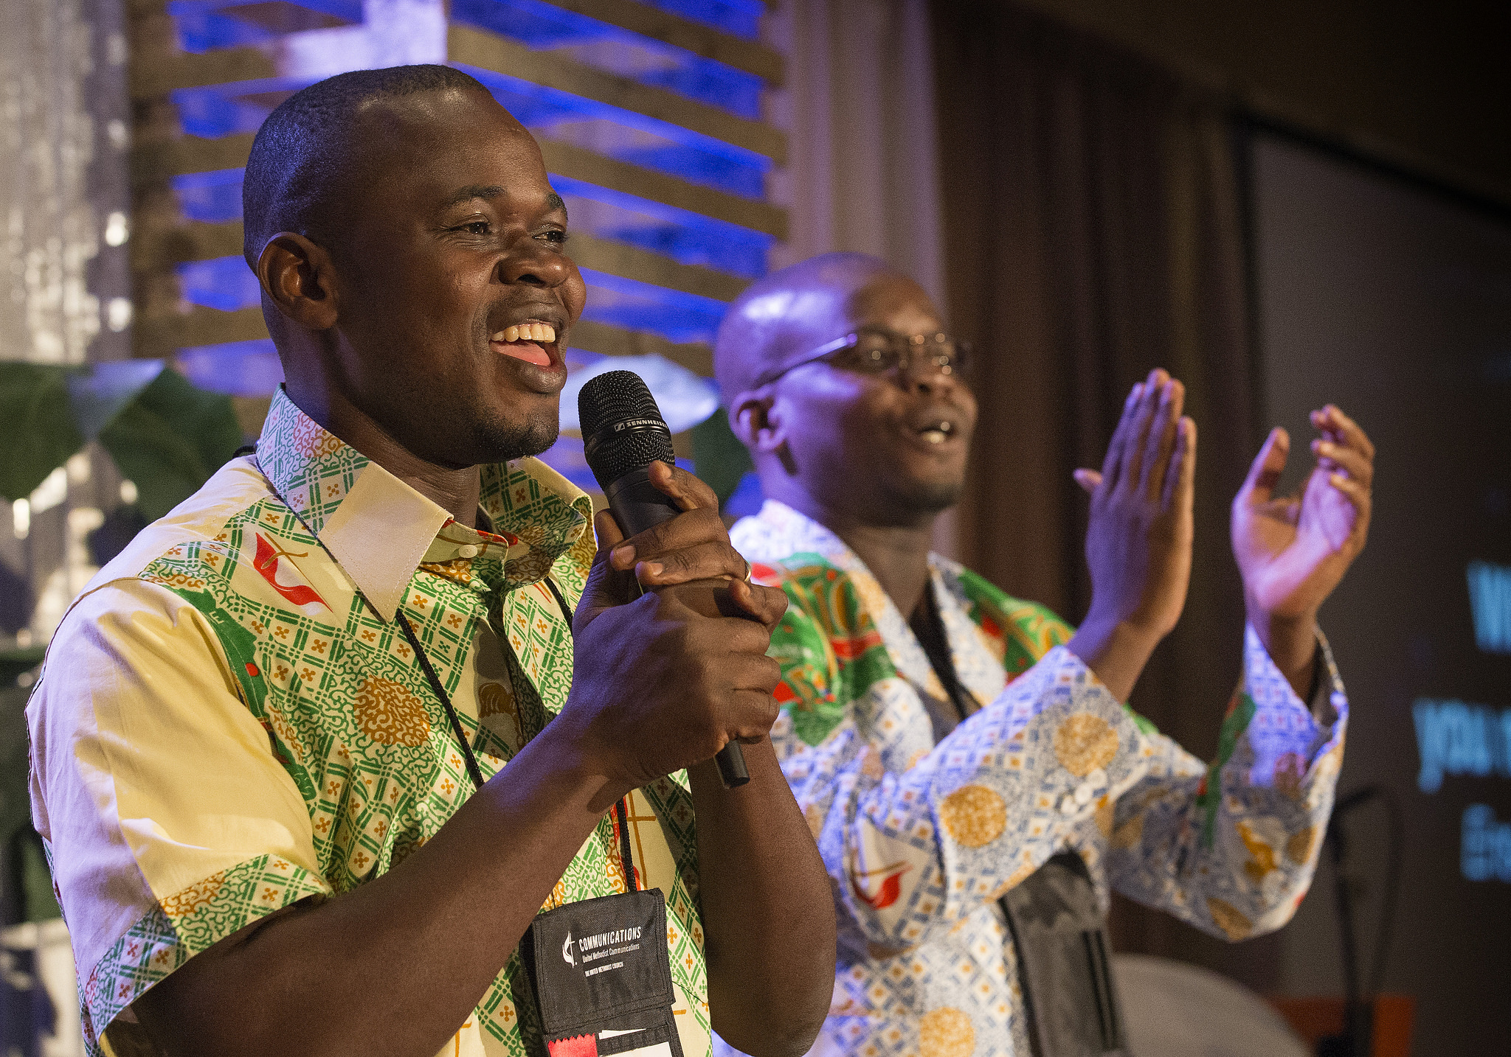


Slide 13



Slide 14
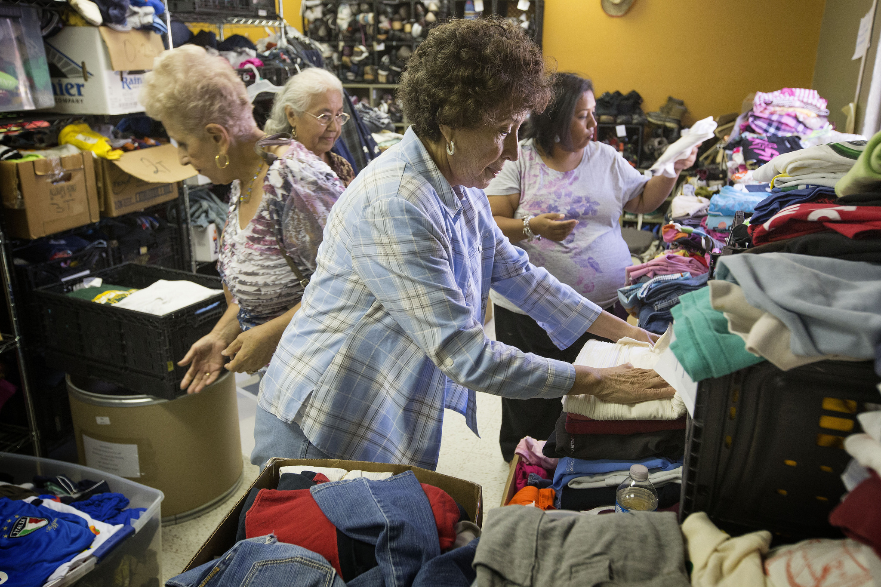


Slide 15



Slide 16
Local Church Lay Servant:
To be designated as a local church lay servant, a church member must complete the following procedure:

Slide 17
Local Church Lay Servant:
Requirements:
“Complete and submit an application to the Pastor, the Church Council (or the Charge Conference) and to the District Superintendent for approval.”

Slide 18

Complete the 10-hour Basic Lay Servant class.

Slide 19
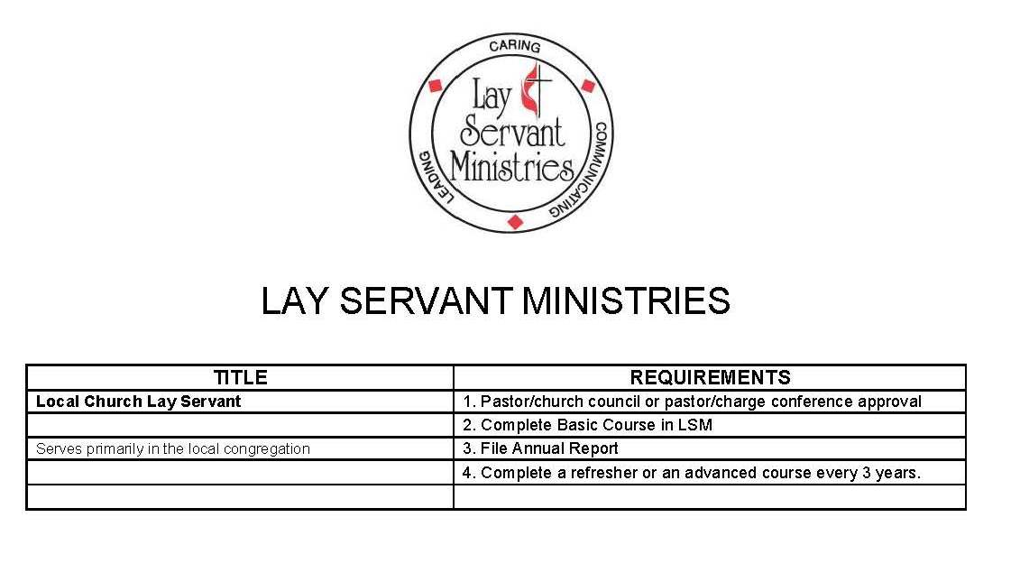

Slide 21
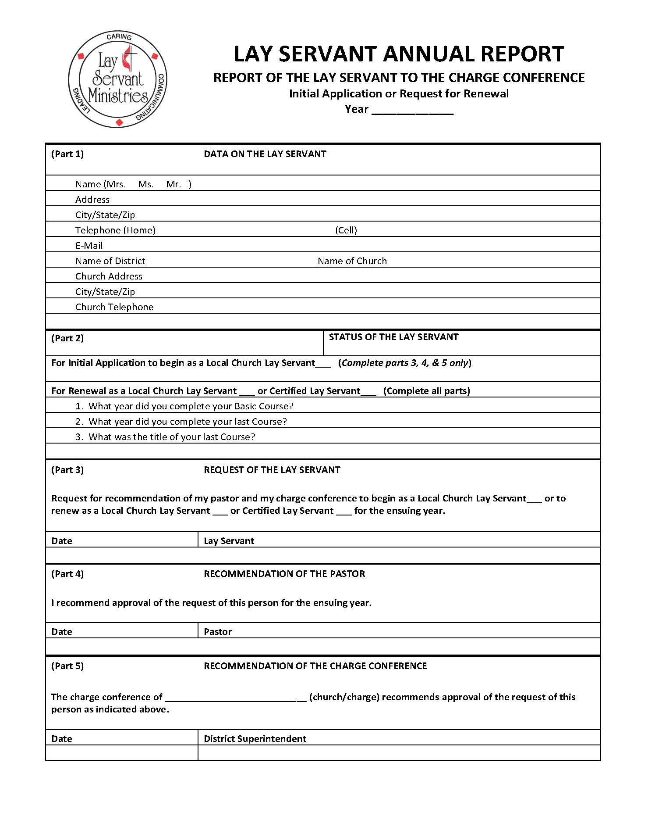

Slide 22

To maintain active status, a Local Church Lay Servant must complete a refresher or an advanced course at least once every three (3) years and must submit an Annual Report every year.

Slide 23
Certified Lay Servants
(2012 Book of Discipline)

Slide 24
Certified Lay Servants:
Serve the local church or charge (or beyond the local church or charge) in any way in which their witness or leadership and service inspires the laity to a deeper commitment to Christ and a more effective discipleship, including through the interpretation of the Scriptures, organization, doctrine, and ministries of the church.

Slide 25
Certified Lay Servant:
Through continued study and training, a Certified Lay Servant should prepare to undertake one or more of the following functions giving primary attention to service within the local church or charge.
When requested by the Pastor, the Certified Lay Servant:

Slide 26

Takes initiative in giving, training, study, and discussion.

Slide 27
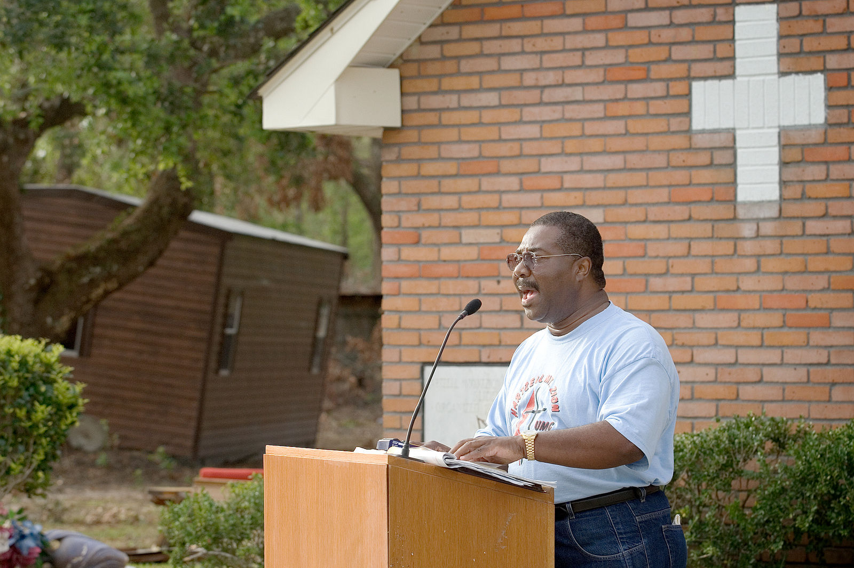


Slide 28

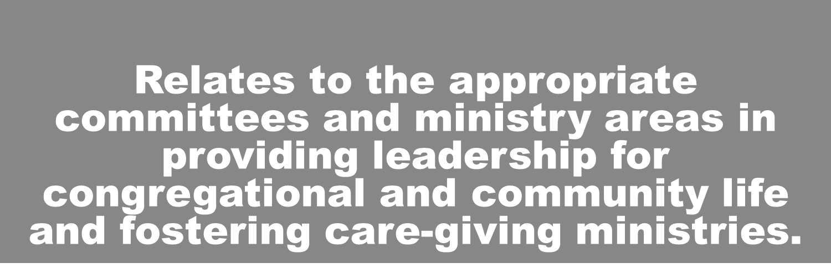

Slide 29
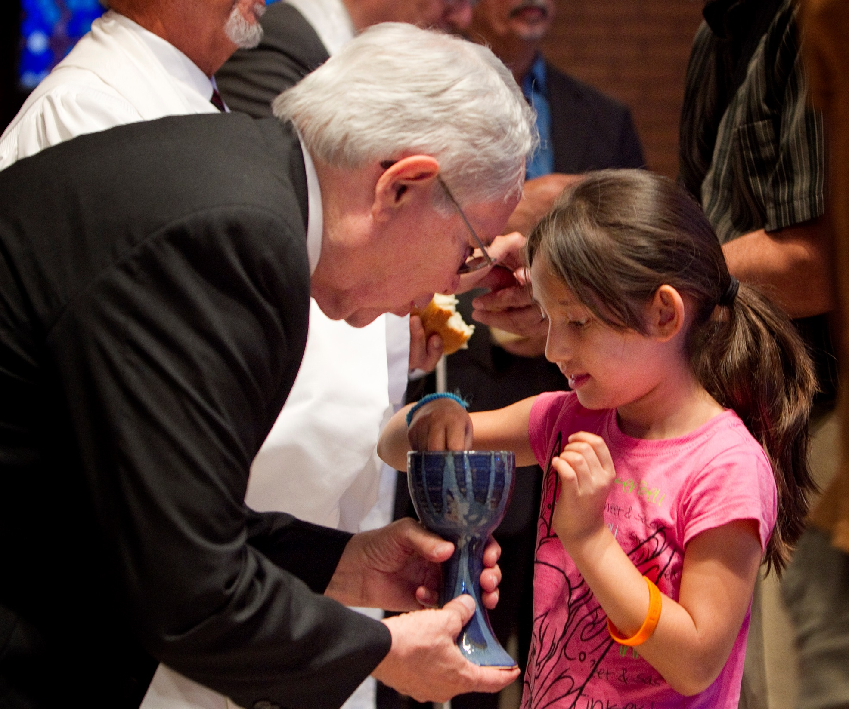
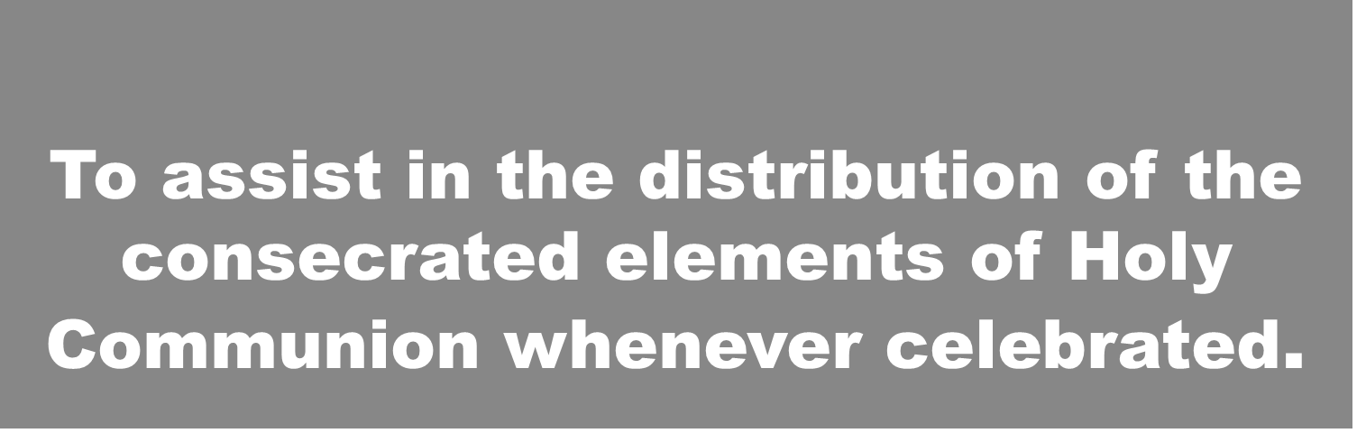

Slide 30
Certified Lay Servants:
To be designated as a Certified Lay Servant, a church member must complete the following procedure:

Slide 31
Certified Lay Servants:
Must have completed all of the requirements for Local Lay Servant and annually complete the Annual Report form showing completion of an advanced 10 hour approved course, with approval of their pastor and the local church charge conference, and the District Superintendent.

Slide 32
Certified Lay Servants:
Complete an advanced 10-hour Lay Servant course at least once every three (3) years and an Annual Report every year.

Slide 35
_________________________________________________________________________________________________
What additional training or support do you need or would suggest to further your ministry as a Lay Servant?
_________________________________________________________________________________________________
_________________________________________________________________________________________________
Give any recommendations you have for improving the Lay Servant Ministries in your District or Conference.
_________________________________________________________________________________________________
_________________________________________________________________________________________________
NOTICE: After this form is completed and signed by those listed above, the Recording Secretary of the Charge Conference is
requested to reproduce THREE copies: (1) Lay Servant, (2) District Director of Lay Servant Ministries, (3) District Superintendent.
The Recording Secretary of the Charge Conference keeps the ORIGINAL.
Revised April 2014

Slide 36
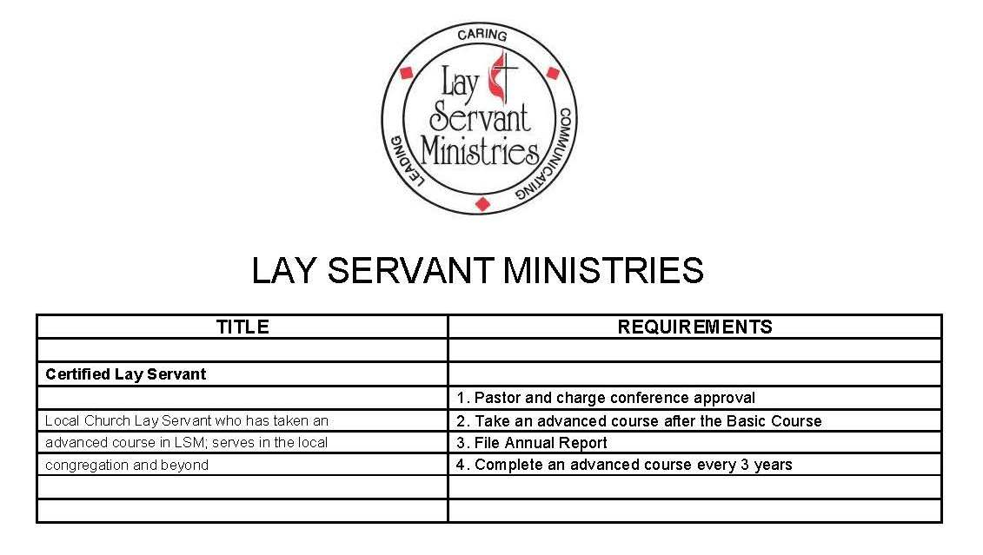

Slide 37

Lay Speaker (Pulpit Supply)
(2012 Book of Discipline)

Slide 38
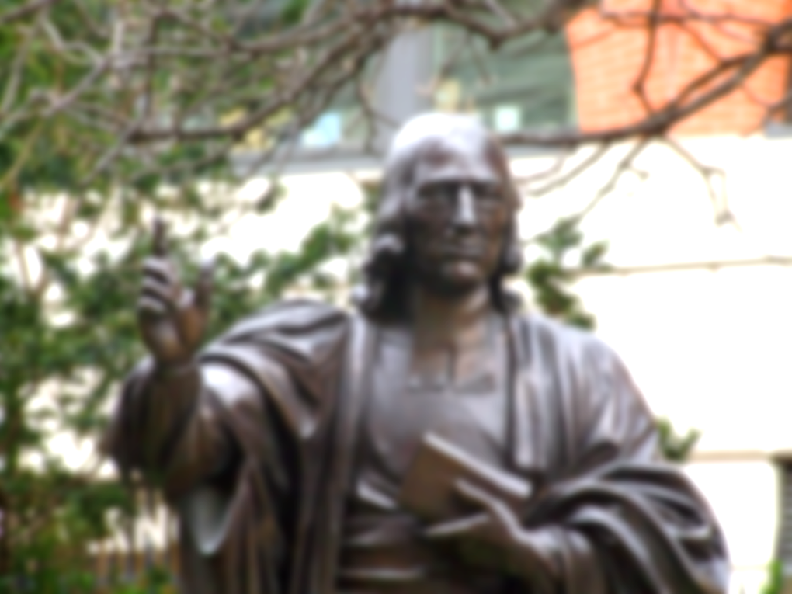
The concept of Lay Speaker is based on the historical tradition of ministry of the laity instituted by John Wesley.

Slide 39
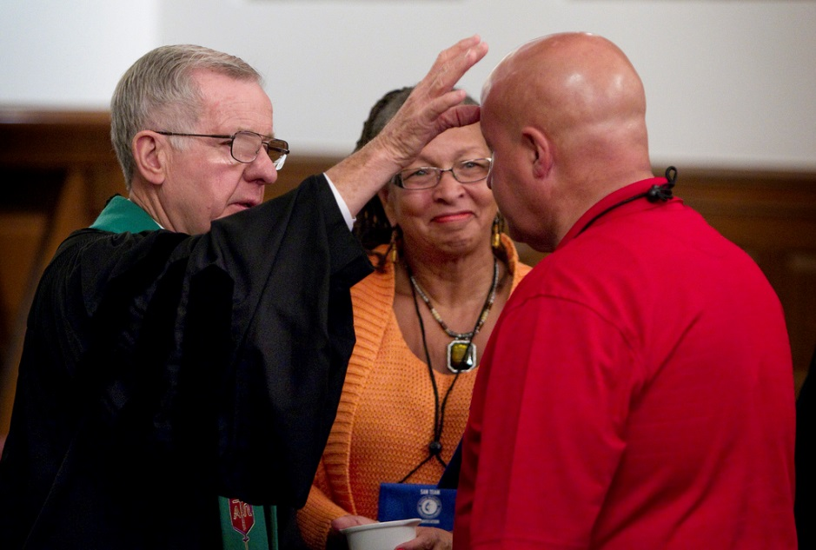
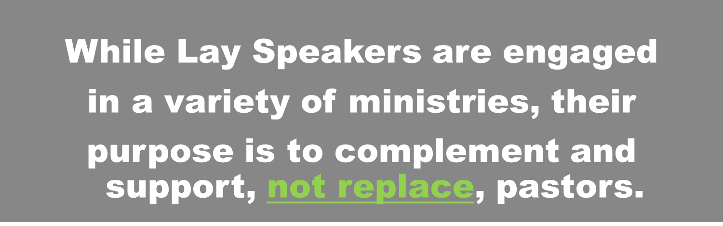

Slide 40

The Lay Speaker will preach the Word when requested by the pastor or in accordance with ¶ 341.1.

Slide 41

Lay Speaker (Pulpit Supply)
Provisions for Lay Speakers: A lay speaker is a professing member of a local church or charge who is called and equipped to serve the church in pulpit supply in accordance and compliance with ¶ 341.1.

Slide 42

Lay Speaker (Pulpit Supply)
The Certified Lay Servant will be recommended by the Pastor of the local church where membership is held. A vote of the Charge Conference, recommending approval of Lay Speaker, forwarded for final approval by the District Superintendent.

Slide 43
Following is a NEW ministry within the Lay Servant Ministries Program established at the 2012 General Conference and included in the 2012 Book of Discipline
TITLE | REQUIREMENTS
Lay Speaker | (Is a Certified Lay Servant)
Certified Lay Servant who provides pulpit supply
 | 1. Must have been recommended for continuation as a Certified Lay Servant for a Minimum of the past three years by their Charge Conference
Required Courses: | 2. Documentation must be completed of the six required Lay Speaker Courses
1. Discovering Your Spiritual Gifts | 3. Interview/Approval by District Committee on LSM
2. Leading in Prayer | 4. File Annual Report
3. Go Preach or From Your Heart to Theirs | 5. Every three years complete one advanced course and interview with District Committee on LSM
4. Living Our United Methodist Beliefs (UM Heritage)
5. Leading in Worship
6. Life Together in the United Methodist Connection (UM Polity)
ANY CERTIFIED LAY SERVANT SEEKING TO PURSUE THE DESIGNATION OF LAY SPEAKER MUST SUBMIT A COMPLETED INITIAL APPLICATION AT THEIR REGULARLY SCHEDULED CHARGE CONFERENCE. (Initial Application Form attached)

Slide 45

Lay Speaker (Pulpit Supply)
Upon receipt of initial application, candidate will receive a letter from the District Director of LSM which will include an explanation of procedures for Lay Speaker (Pulpit Supply)
Remaining Course Work
Typed Sermon
Full Order of Worship, including songs, scripture and prayers
Once assembled, they are to be mailed to:
The District – Director of Lay Servant Ministries.

Slide 46
Lay Speaker (Pulpit Supply)
When the materials are received by the District Director of Lay Servant Ministries, he/she will call a meeting of
the District Committee on Lay Servant Ministries
To review the materials and establish a time and place to meet with the candidate for a personal interview.

Slide 47
District Committee on LSM
The District Committee on Lay Servant Ministries will consist of:
The District Director of Lay Servant Ministries or Associate;
An Elder in the United Methodist Church,
A local Pastor,
A Certified Lay Servant/Lay Speaker (as individuals transition through training, service and approval), and the
The District Lay Leader.

Slide 48

Lay Speaker (Pulpit Supply)
If a candidate is Not approved to become a Lay Speaker he/she will be given the opportunity to improve on the recommendations of the committee and request a re-evaluation by the committee after a period of six months.

Slide 49
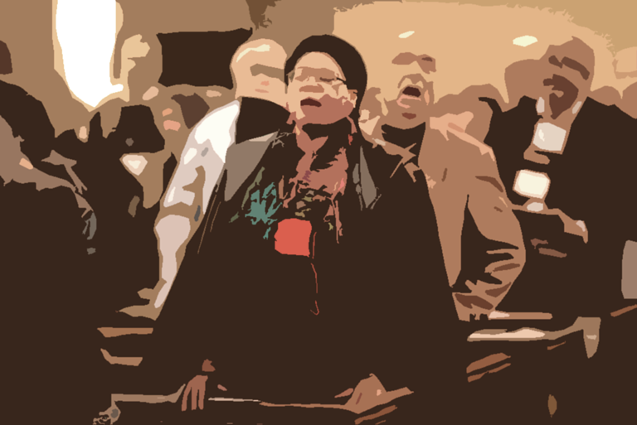
Lay Speaker (Pulpit Supply)
Remember that the Pastor is the first person who has to approve the Local Church and Certified Lay Servants to enroll in the Lay Servant Program. For Lay Servants, it may take four to six years or more to complete the required course work for the “Lay Speaker” Track.

Slide 50
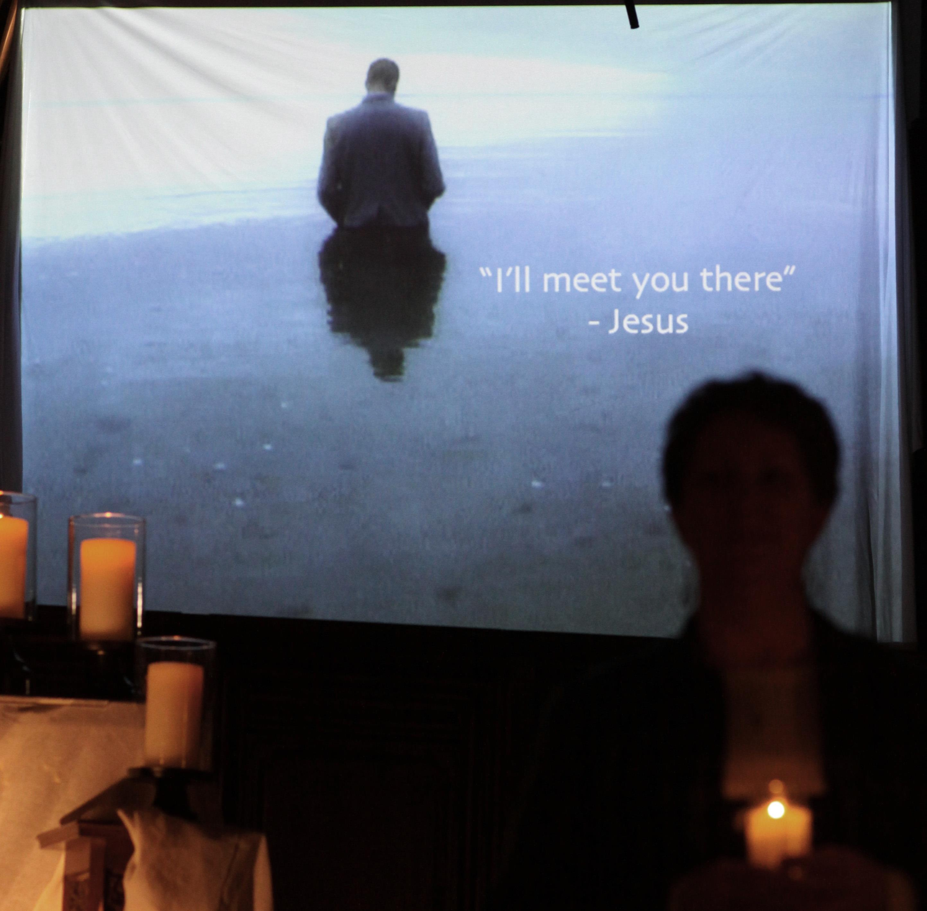
LET’S TAKE THIS TO PRAYER

Slide 51
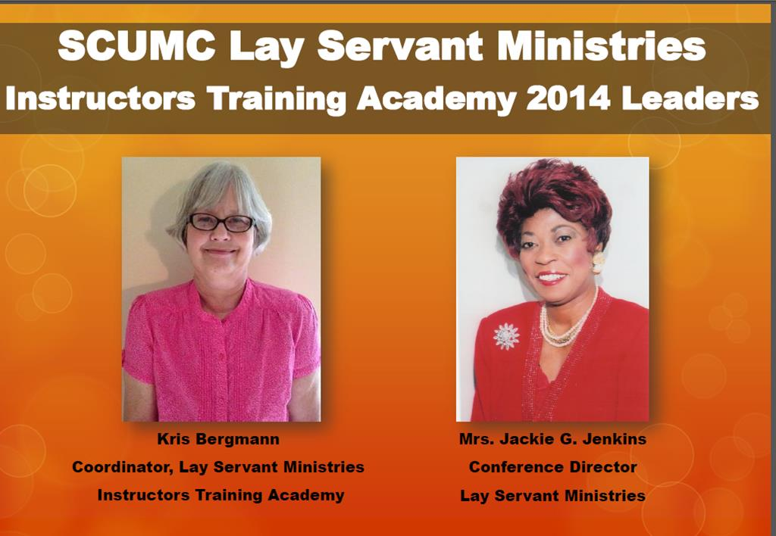

Slide 52

Lay Servant Ministries
May GOD bless us all as we strive to do his will!
Thank you for your time and future support.

Slide 53
